Slide 1
Hardware
The part of a computer you can kick.

Slide 2
Parts of a Computer
Made of ICs (more in depth in second half)
All interchangeable thanks to ATX
This is why you can (usually) upgrade any desktop parts

Slide 3
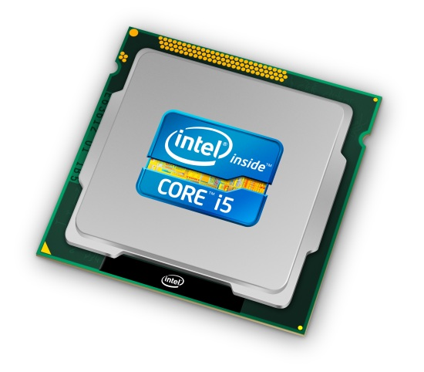
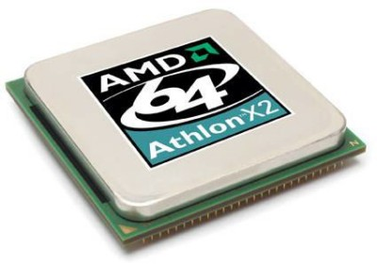
CPU
Central Processing Unit
“The Brain”

Slide 4
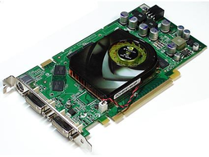
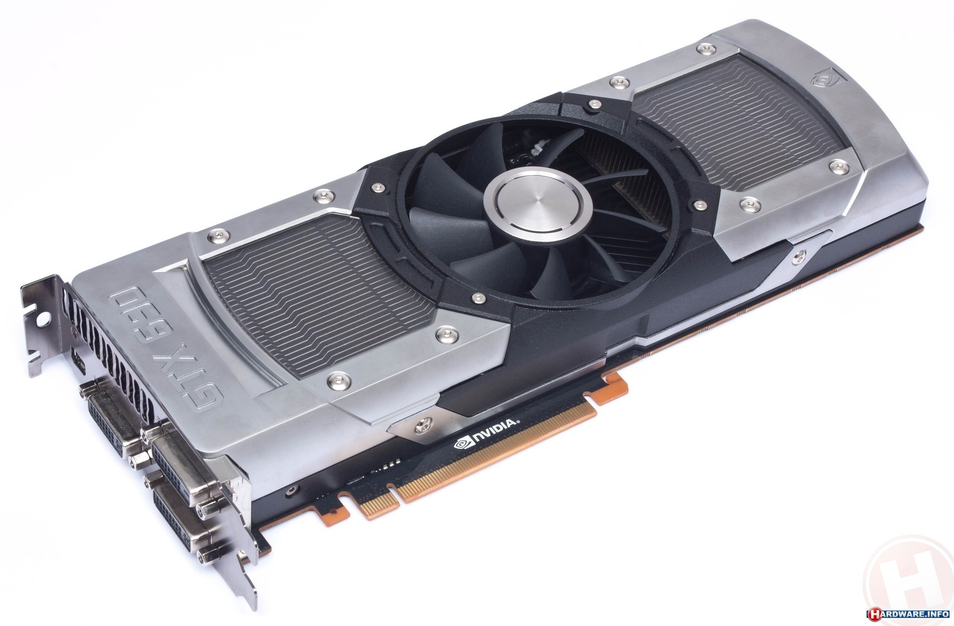
GPU (optional)
Graphical Processing Unit
“The Brain”... but for graphics
Very could at parallel simple calculations (for images)
Integrated vs. dedicated

Slide 5


Slide 6
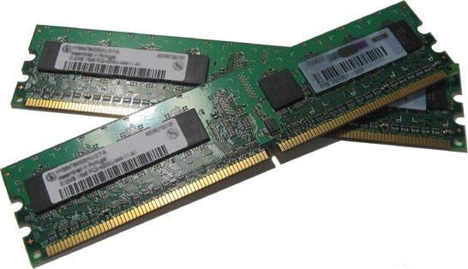
RAM
http://downloadmoreram.com/
Contrary to popular belief, you cannot download more RAM :(
Fast memory (where things are stored short-term)
2 - 32 GB

Slide 7

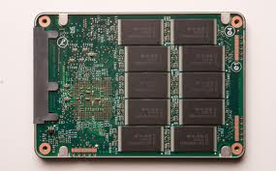
Storage
Large, slow storage
Where files are stored
HDD and SSD (and RAM disks)
100 - 2000 GB

Slide 8
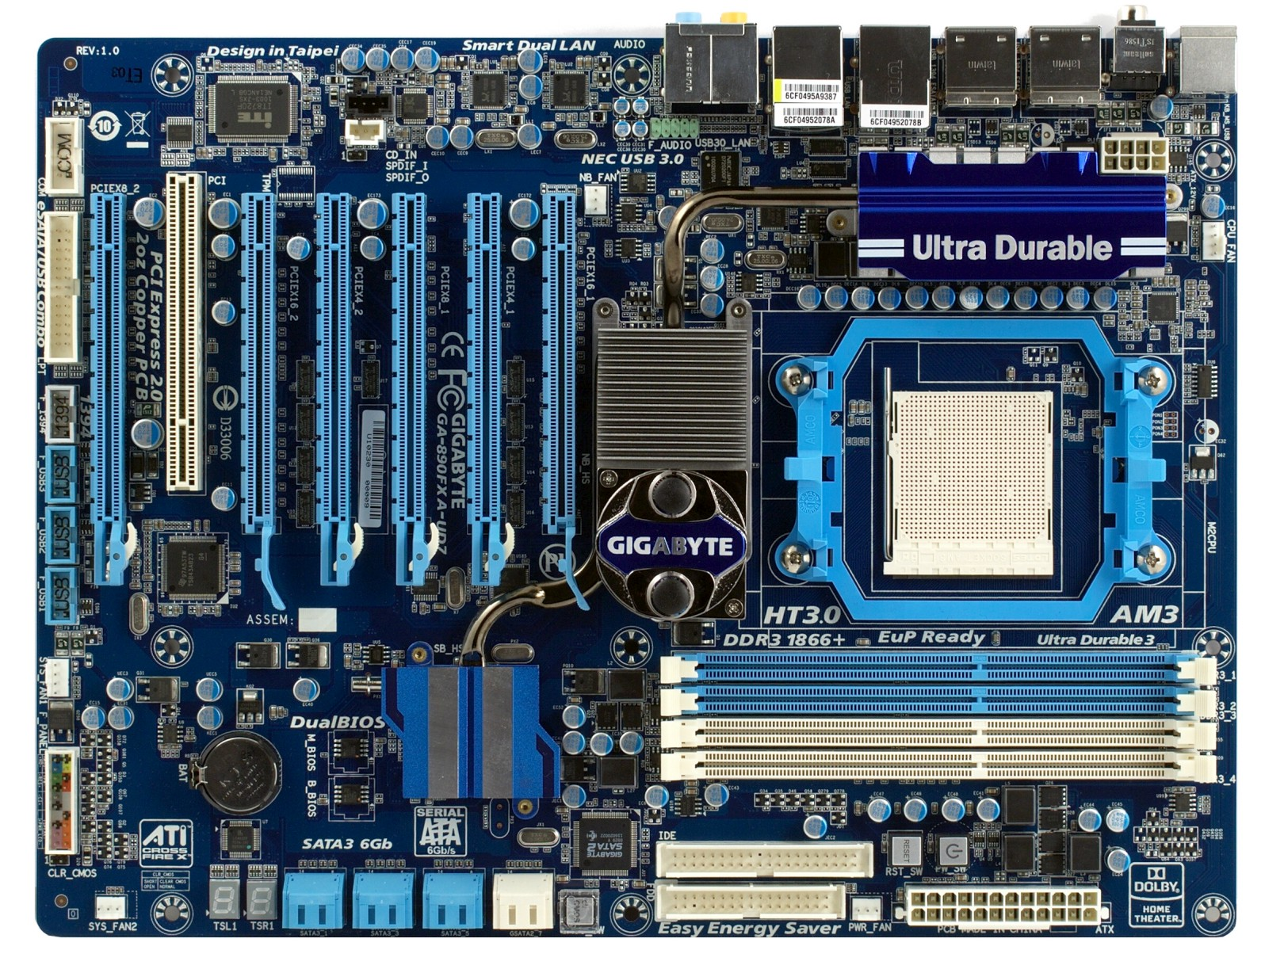
Motherboard
Putting
everything
together
Onboard
components

Slide 9
Peripherals
Keyboard
Mouse
Monitor
Speakers/headphones
(we assume you know what these look like and don’t need pictures)

Slide 10
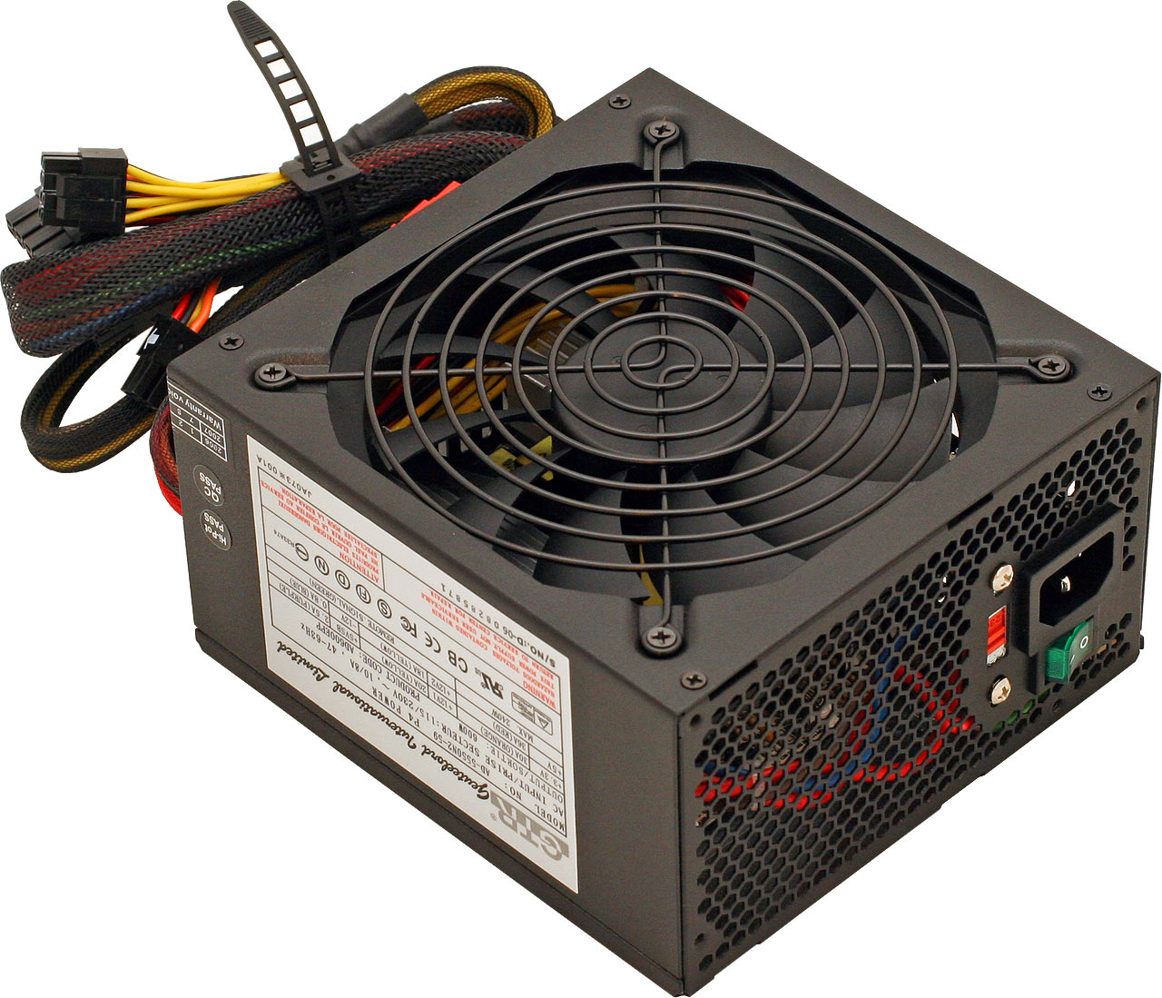
Power Supply
Supplies power
(terribly exciting, we know)

Slide 11
Questions?

Slide 12
Now for real life examples...
(you get to watch Jake break his computer)

Slide 13
And now, last week’s problem...

Slide 14
The new problem awaits you on the server...

Slide 15
More Advanced...
The part of a computer you can conceptualize with advanced logic gates.

Slide 16
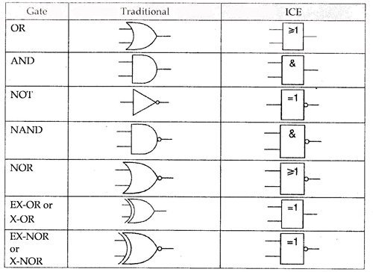
Logic Gates
^ ignore this stuff...

Slide 17
How They’re Made
See whiteboard…
(basically made of transistors; this is why transistor counts are advertised. Ex/ Intel Ivy Bridge 4C is a 1.2 billion transistor processor)

Slide 18
What It Actually Looks Like
http://download.intel.com/pressroom/kits/corei7/images/Nehalem_Die_Shot_2.jpg

Slide 19
CPU vs. GPU
Both “brains”
CPU: 2 to 8 cores
GPU: hundreds to thousands
Lots of simple things vs. a few complicated things

Slide 20
Image Comparison
Our good friend
http://download.intel.com/pressroom/kits/corei7/images/Nehalem_Die_Shot_2.jpg
and http://i.imgur.com/Fssv9.jpg

Slide 21
Questions?

